Slide 1


Online Registration

Slide 2
Starting Online Registration For Your Herd
Before doing anything else – call Kathy!
  Kathy will provide you your customer number to login and create your account
Link to Online Registration: https://i4.abri.au/online/cgi-bin/i4.dll?1=usms&2=lo
Note these are not available for Online Registration
  ET Calves
  Bulls
  Transfers cannot be done online as the signed transfer paper is needed.

Slide 3
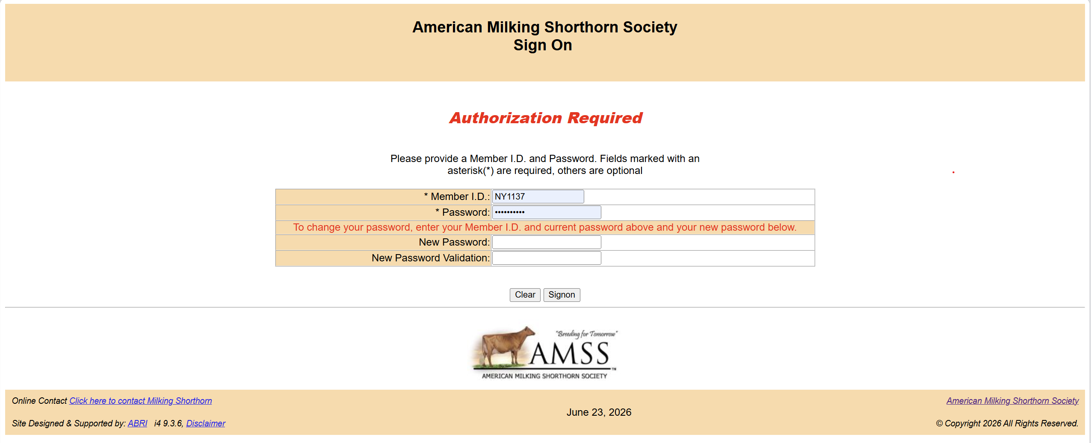

Slide 4
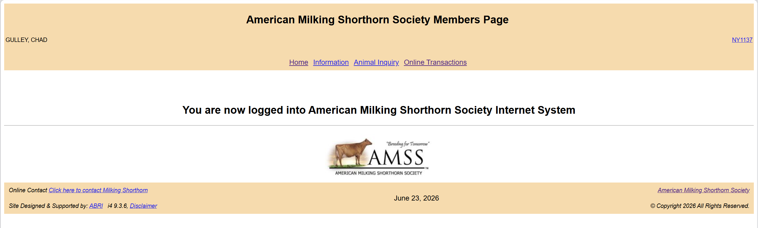
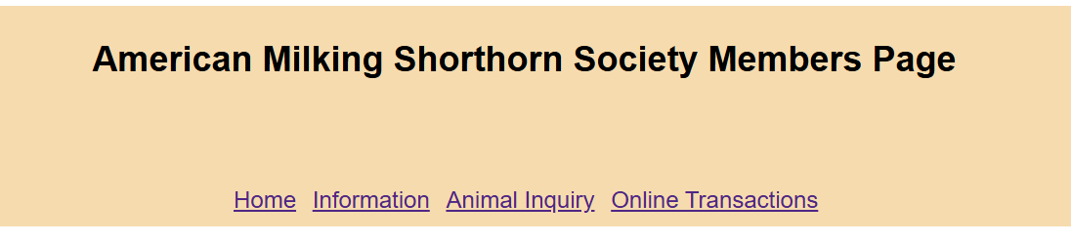
Takes you to the AMSS Home Page
Information does not currently do anything.
Click here to Register animals
Look up Pedigrees and find more information on animals

Slide 5
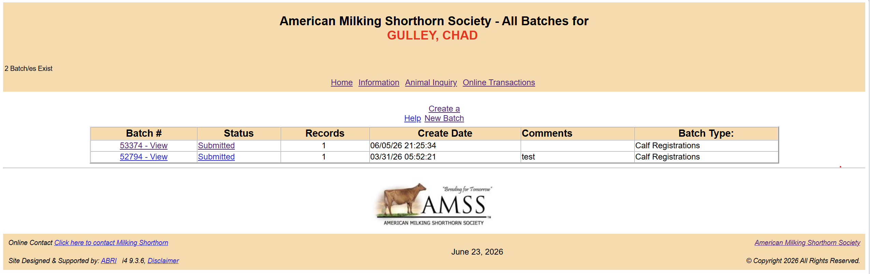

Slide 6

To Register animals – click ‘Create a New Batch’

Slide 7
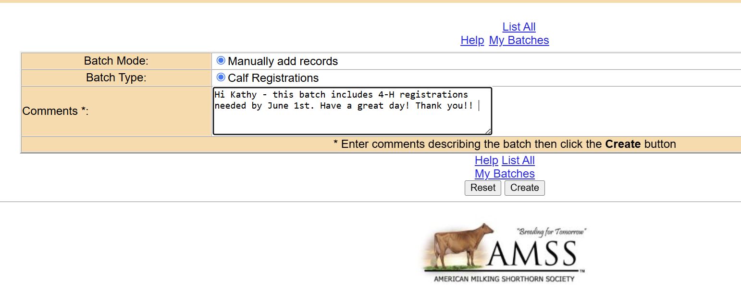
Add comments for Kathy – same as you would in an email.
Then ‘Create’

Slide 8
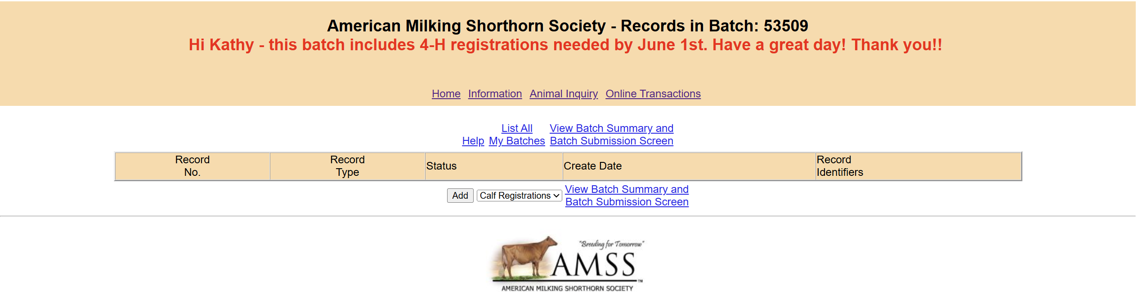
This is your batch – click – Add to start a registration

Slide 9
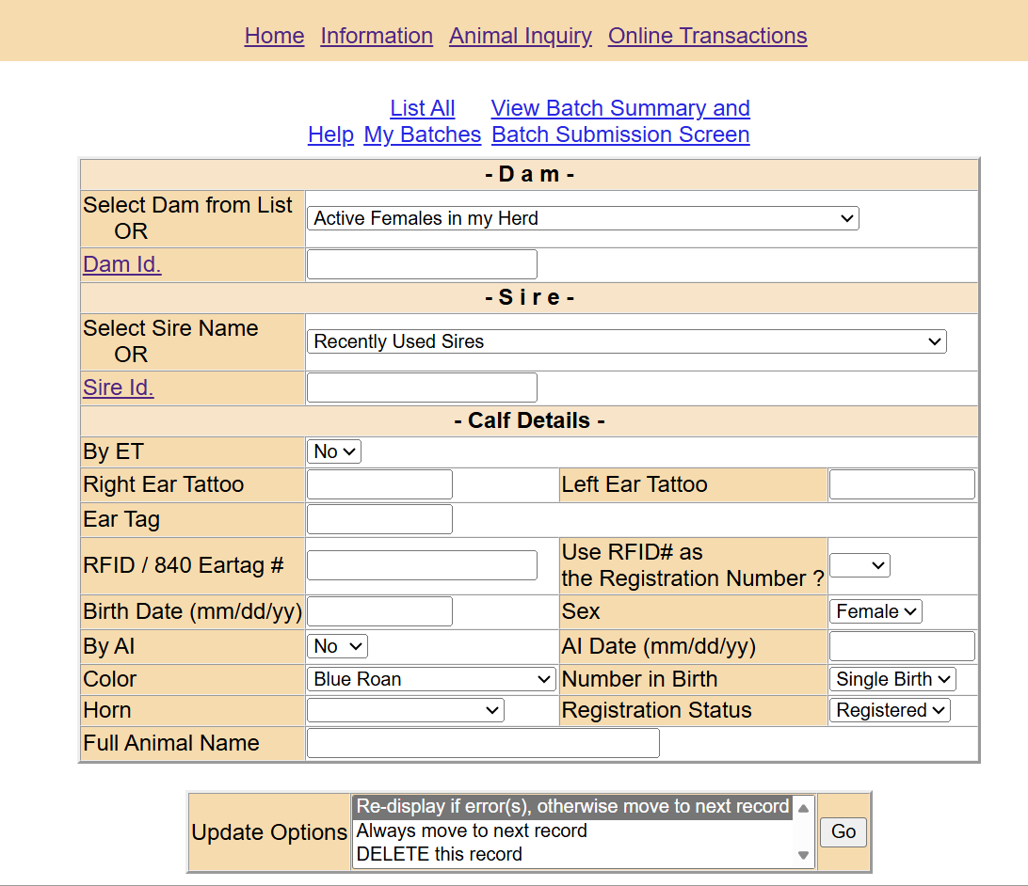
The dropdowns will help you
DAM includes your Dams to choose from
Dam ID = REGISTRATION NUMBER
SIRE has recently used Sires
Sire ID = REGISTRATION NUMBER
Color –
  Be careful to select the one you want from the list

Slide 10
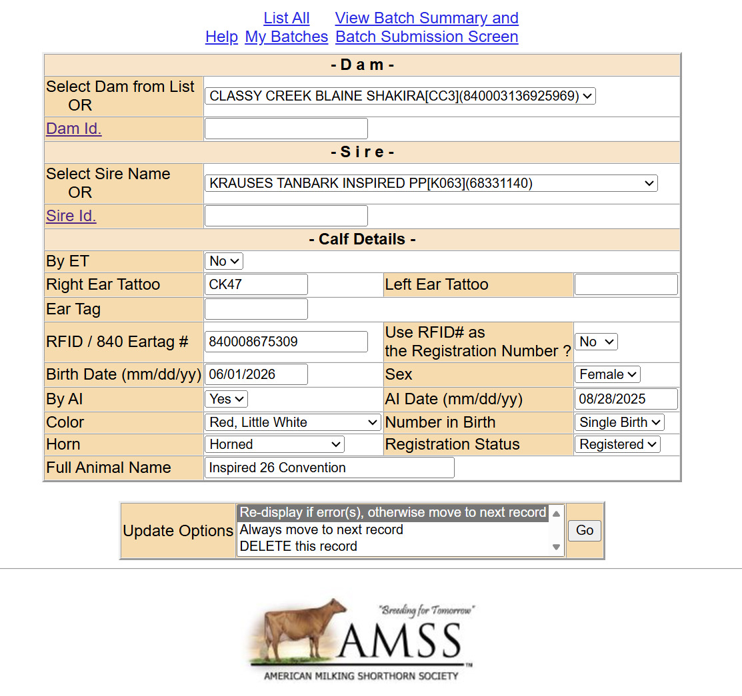

Slide 11
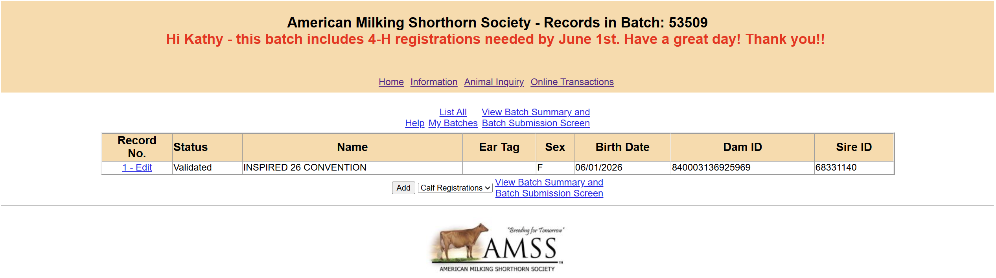
Add – to add additional animals to the batch
Edit – to view the animal or make edits
Once you are finished – click View Batch Summary and Batch Submission Screen

Slide 12
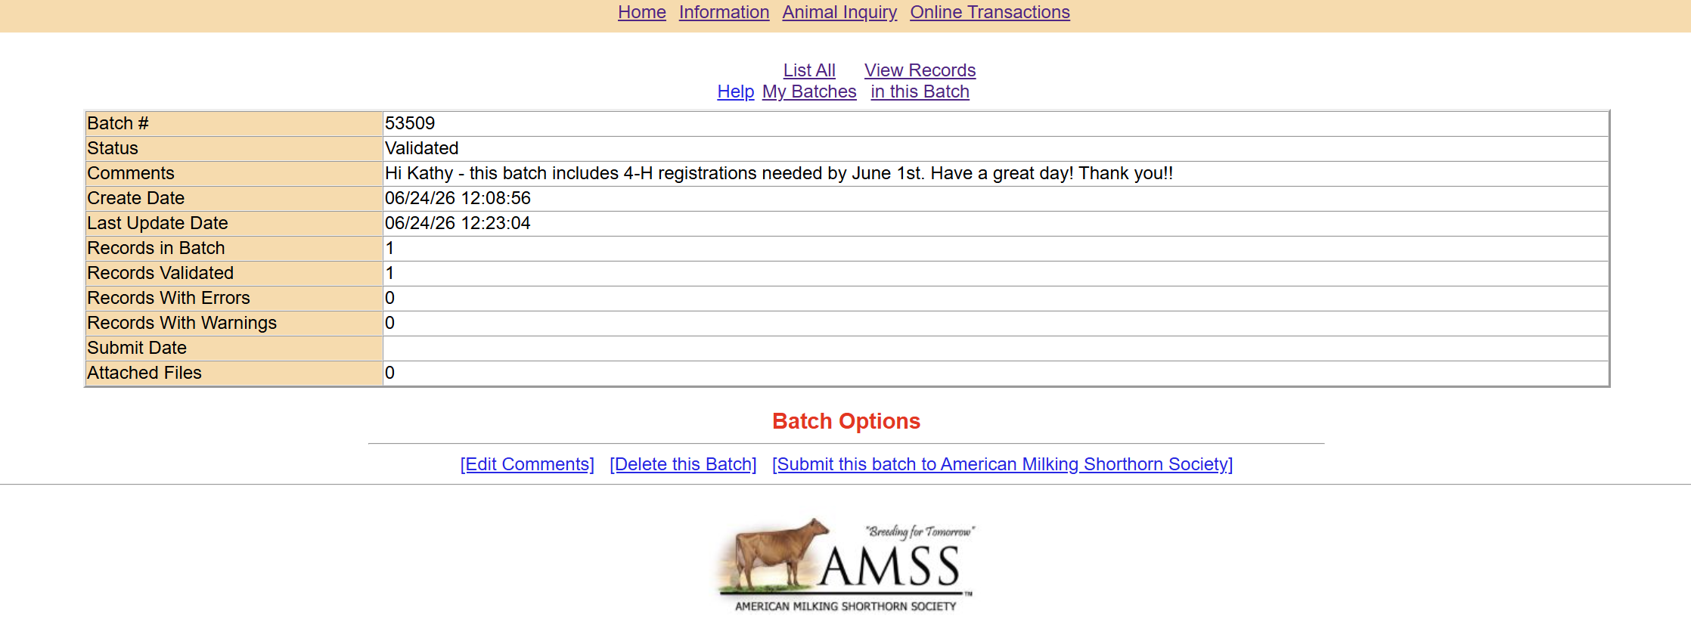
View Records in this Batch to see the animals included for final review.
Submit this batch to send it to the office.
Edit Comments if needed.
Delete this batch if and only if you truly created it in error – once deleted it cannot be restored.

Slide 13
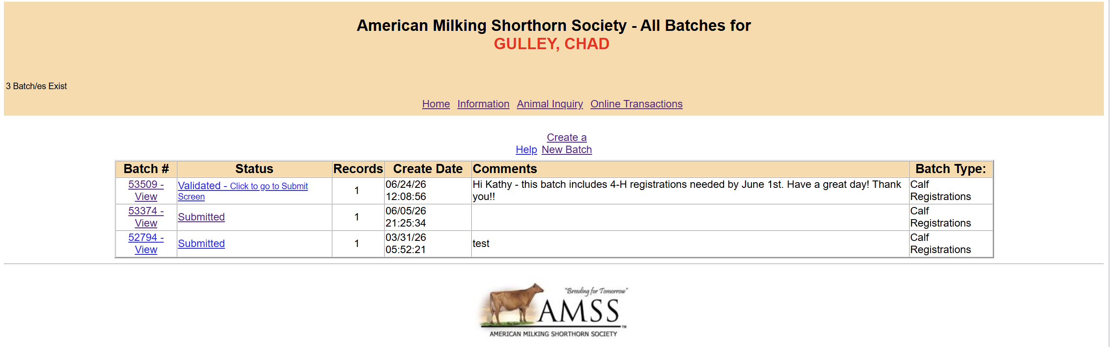
List all My Batches shows all of your batches and if you submitted them to the office.

